Slide 1
Unit 1—Lesson 1:
Introduction to Swift and Playgrounds
Notes:
Say
Let’s get started.
In this lesson, you'll learn about the origin of Swift and some of its basic syntax.

Slide 2

A little history
Swift was introduced at WWDC 2014 as a modern language for writing apps for iOS and macOS.
It replaces Objective-C as the primary language for iOS and macOS.
It’s easier than other languages to learn, read, write, and maintain applications.
Notes:
Say
Swift was introduced at WWDC 2014 as a modern language for writing apps for iOS and macOS.
It replaces Objective-C as the primary language for iOS and macOS.
It’s easier than other languages to learn, read, write, and maintain applications.

Slide 3
A modern language
SAFE
FAST
EXPRESSIVE
Notes:
Say
Swift is a modern language—it’s safe, fast, and expressive.
Do
Explain the meaning of "safe," "fast," and "expressive."
Explain the key features:
Clean syntax
Optionals
Type inference
Type safety
Automatic Reference Counting (ARC) for memory management
Tuples and multiple return values
Generics
Fast and concise iteration over collections
Structs that support methods, extensions, and protocols
Map, filter, reduce, and other functional programming patterns
Powerful error handling

Slide 4

A modern language
Key features:
  Clean syntax
  Optionals
  Type inference
  Type safety
  Automatic Reference Counting (ARC) for memory management
  Tuples and multiple return values
  Generics
  Fast and concise iteration over collections
  Structs that support methods, extensions, and protocols
  Map, filter, reduce, and other functional programming patterns
  Powerful error handling
  Protocol Oriented Programming
Notes:
Say
Swift is a modern language—it’s safe, fast, and expressive.
Do
Explain the meaning of "safe," "fast," and "expressive."
Explain the key features:
Clean syntax
Optionals
Type inference
Type safety
Automatic Reference Counting (ARC) for memory management
Tuples and multiple return values
Generics - “code that can be used in multiple scenarios”
Fast and concise iteration over collections
Structs that support methods, extensions, and protocols
Map, filter, reduce, and other functional programming patterns
Powerful error handling

Slide 5
A safe language
Explicit object "types"
Type inference
Optionals
Error handling

Slide 6
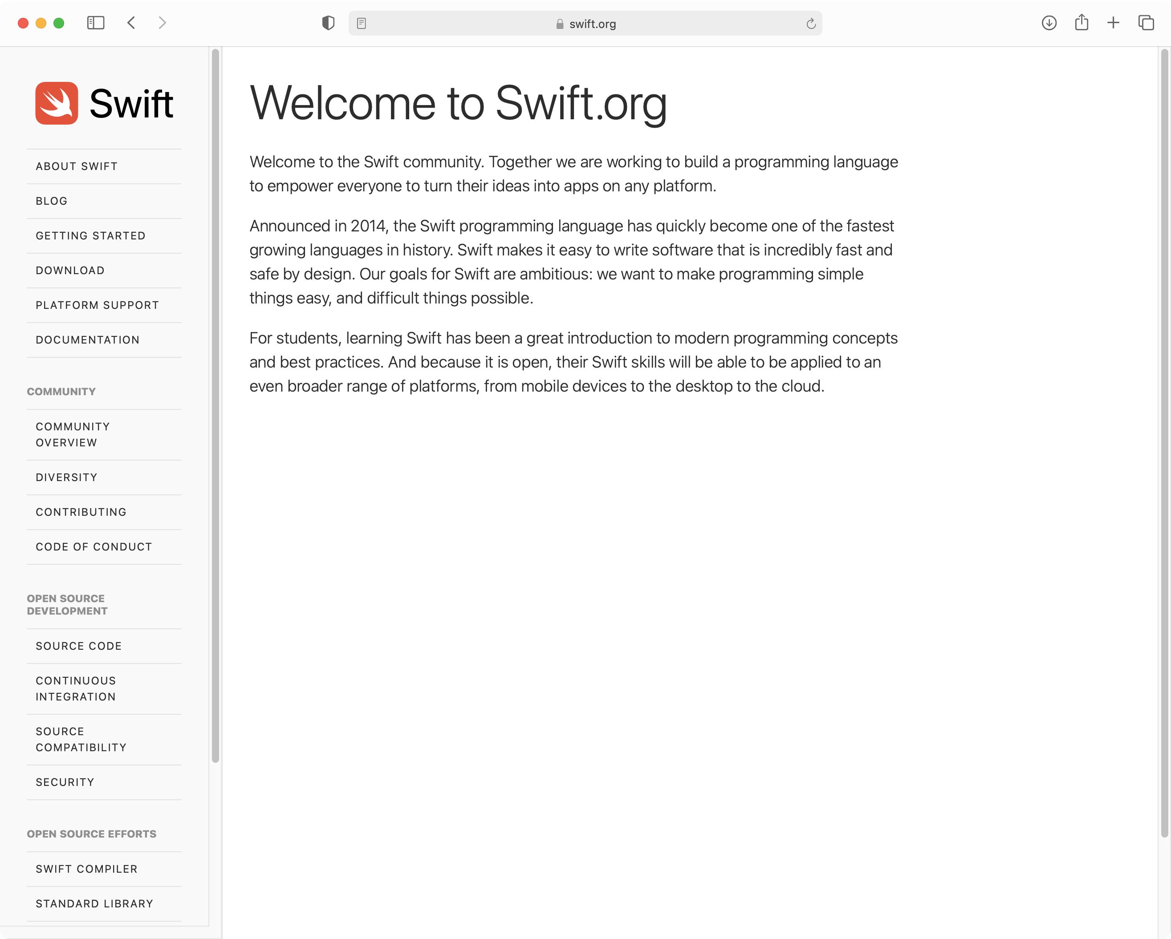
Open Source
Notes:
Say
Swift was released as open source in December 2015.
"Open source" means that there’s community input and support, it’s evolving and improving, and there’s support for more platforms over time.
For more information, go to Swift.org.

Slide 7

Hello, world
print("Hello, world!")
main.swift
Notes:
Do
Describe the Swift file format (plain text, .swift file extension, one or more statements, and so on).
Explain that there’s one file for code and definitions.
Demonstrate how the simplest app to write is "Hello, world!"

Slide 8

Hello, world
Open Terminal
Type swift repl and press Enter
Type print("Hello, world!") and press Return
Type :quit and press Return
Quit Terminal
Notes:
Say
Swift comes with the REPL (Read, Eval, Print Loop) tool to evaluate simple commands.
Do
Quickly demonstrate creating "Hello, world!" in Swift in Terminal. Students can follow along.

Slide 9
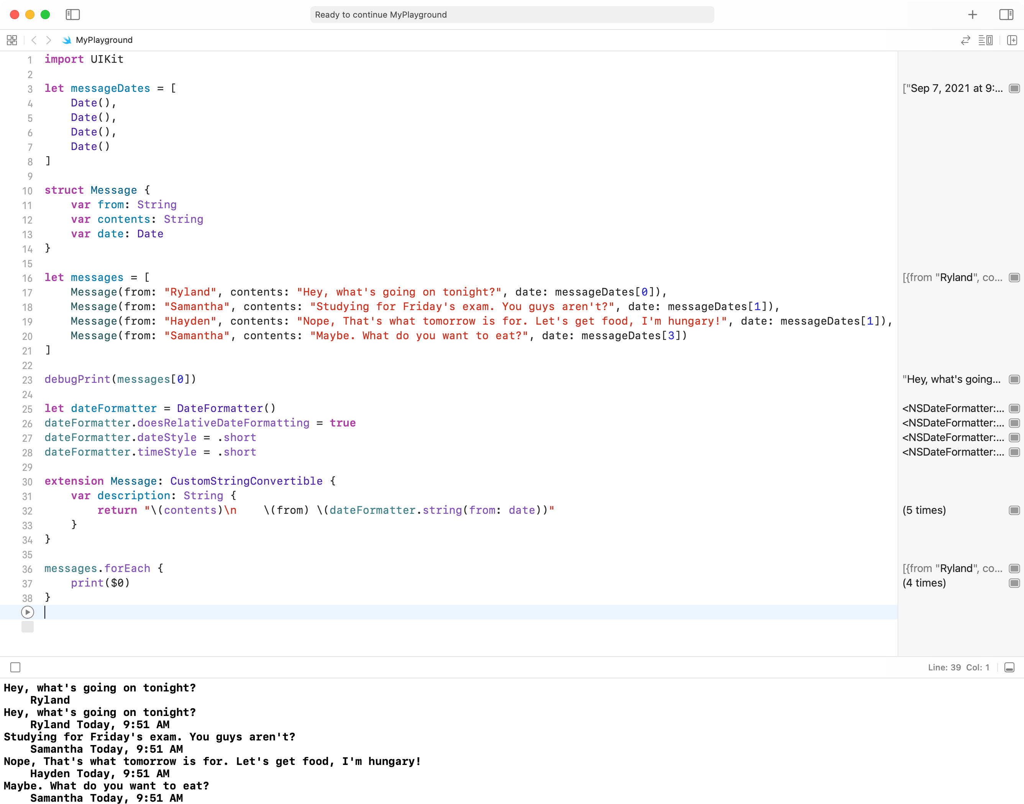
`
Notes:
Do
Open an example playground and describe the playground environment.
Show the lower-left run button: Click and hold and show “Automatically Run" and “Manually Run."
Show the lower-right show/hide debug area.
Show the right column output.
Say
You can hover over output to see the eye icon inspector.
[Click the eye for a popover with the output.]
You can click the “Show Results” to toggle the results inline display.
Do
Show the the assistant editor button and how to enable/disable Live View

Slide 10
Hello, world
Open Xcode
Choose File > New > Playground
Select iOS, select the Blank template and click Next
Name the playground "Hello, world!"
Click Create to save the playground
Add print("Hello, world!”)
Replace "Hello, world!" with str
Notes:
Do
Present this as a group activity, with participants following along on their own computers.
As you go through this procedure with the participants, discuss the autocomplete feature while you enter the print statement.

Slide 11

Unit 1—Lesson 1
Open and complete the exercises in Lab - Introduction.playground

